Slide 1
Signals and Communication Systems
AM and FM Transmitter and Receiver

Slide 2
AM Transmitters

Slide 3
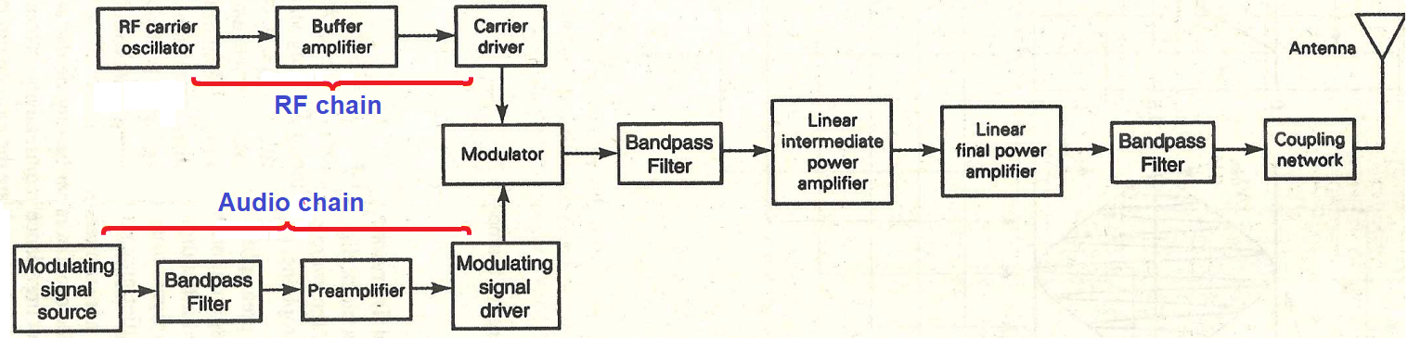
Low-Level Transmitters:

Slide 4
Audio Chain: For voice or music transmission, the source of the modulating signal is generally an acoustical transducer, such as a micro-phone, a magnetic tape, a CD, or a phonograph record.
Pre-amplifier: The preamplifier is typically a sensitive, class-A linear voltage amplifier with a high input impedance.
Driver amplifier: The driver amplifier for modulating signal is also a linear amplifier that simply amplifies the information signal to an adequate level to sufficiently drive the modulator. More than one driver amplifier may be required.
RF Chain: The Radio Frequency chain consists carrier oscillator, isolated buffer amplifier and carrier driver.

Slide 5
Buffer Amplifier: The purpose of the buffer amplifier is twofold. It first matches the output impedance of the carrier oscillator with the input impedance of the frequency multiplier, the next stage of the carrier oscillator. It then isolates the carrier oscillator and frequency multiplier.
This is required so that the multiplier does not draw a large current from the carrier oscillator. If this occurs, the frequency of the carrier oscillator will not remain stable. Emitter followers or integrated-circuit op-amps are often used for the buffer.
Modulators: Various kind of modulation techniques are implemented in this block. The modulator can use either emitter or collector modulation.

Slide 6
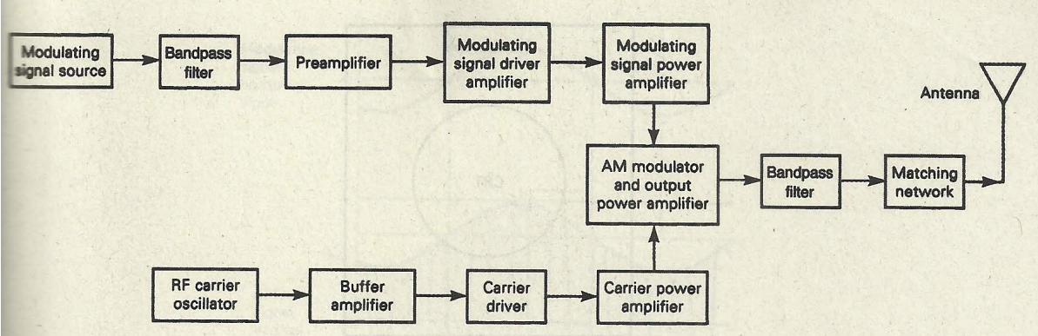
High-Level and Low-Level Transmitters:

Slide 7
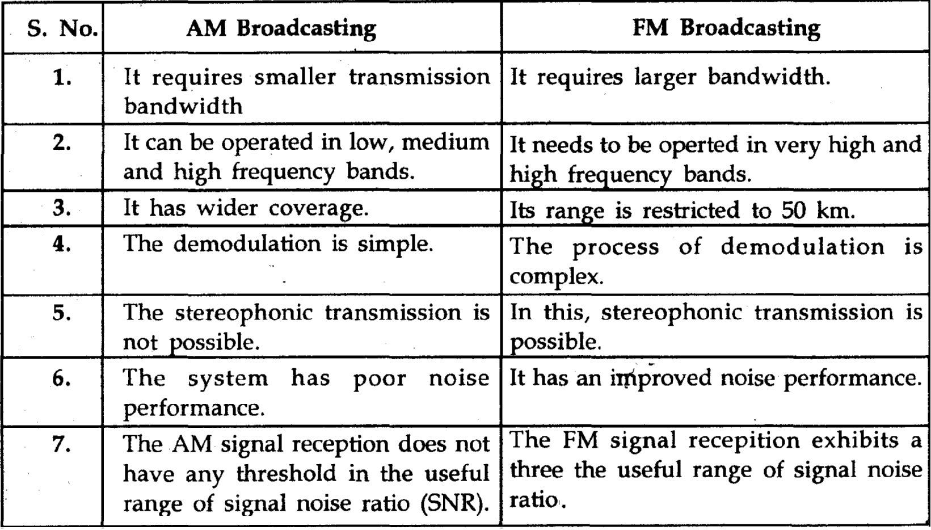
Differentiate between AM and FM broadcasting.

Slide 8
End

